Slide 1
Lake gore
WA wetlands

Slide 2
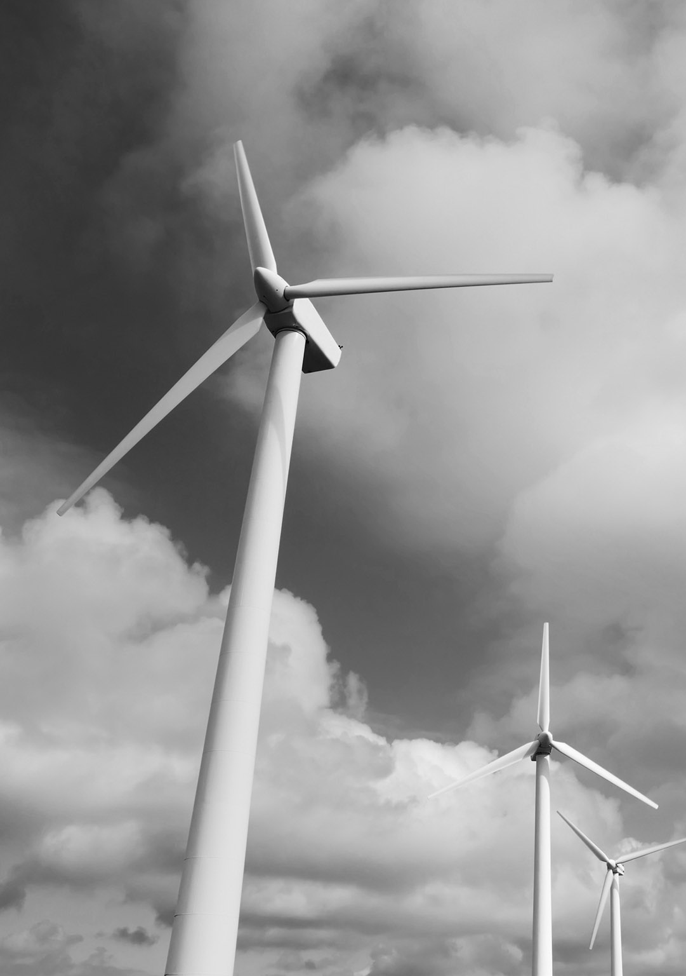
Where is lake gore located
Lake gore
Lake gore is located 34 kilometres North West of Esperance.
Coordinates are 33.7717° S, 121.5217° E
This map displays where about its located.

Slide 3
Criterion this wetland covers
Lake gore
Lake gore cover criteria 4,5 and 6.
It covers criteria 4 due to animals being at a critical endangered stage in the wetland and they are providing refuge during adverse conditions.
5 is covered by supporting over 20,000 water birds
6 because it supports 1% of a species or sub species of water bird.

Slide 4
Flora and fauna
Lake gore
Fauna around or inside of lake gore consists of Hooded Plovers (Endangered Species), Chestnut Teal and Australasian Shoveler.
Flora consists of Melaleuca Cuticularis, Ghana Trifida and Sarcorcornia Quinqueflora.

Slide 5
What type of wetland is it?
Lake gore
Lake Gore is a saline wetland and has a downstream system of inter connected lakes.
The site contains open woodland of saltwater paperback trees, sedge understory and low shrub lands of samphire and grasses.
Still regarded as significant areas for fishing and food gathering.

Slide 6
What it’s used for?
Lake gore
Lake gore is currently used for Nature conservation and pasture gazing.
The surrounding area is currently used for nature conservation, pasture gazing and cereal cropping.

